Slide 1

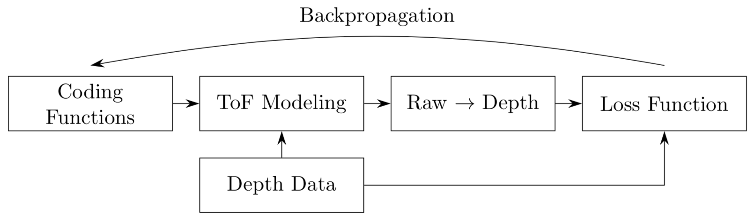
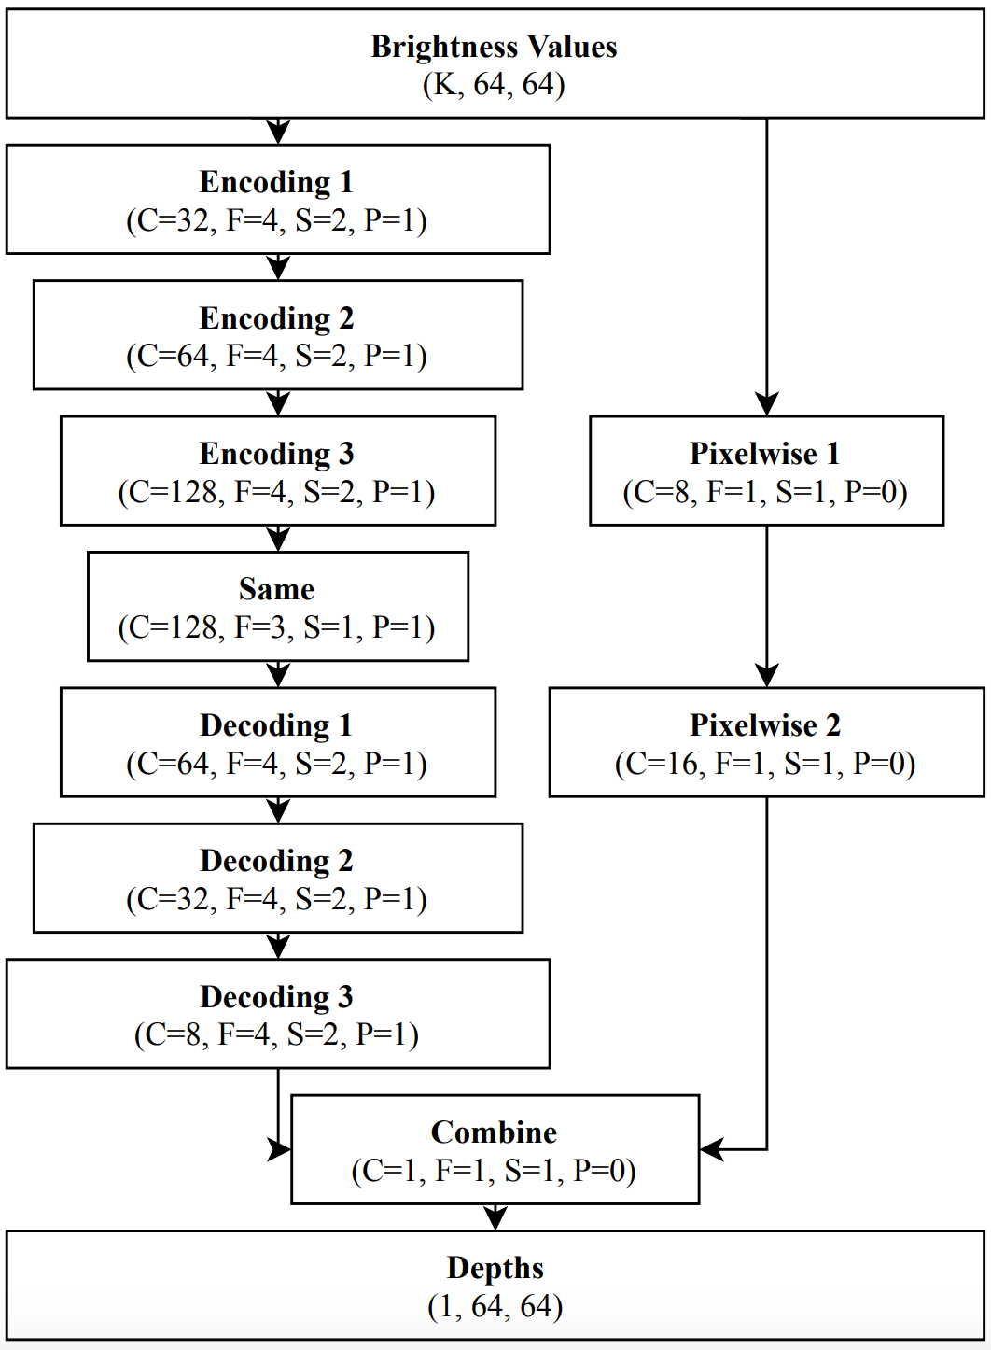
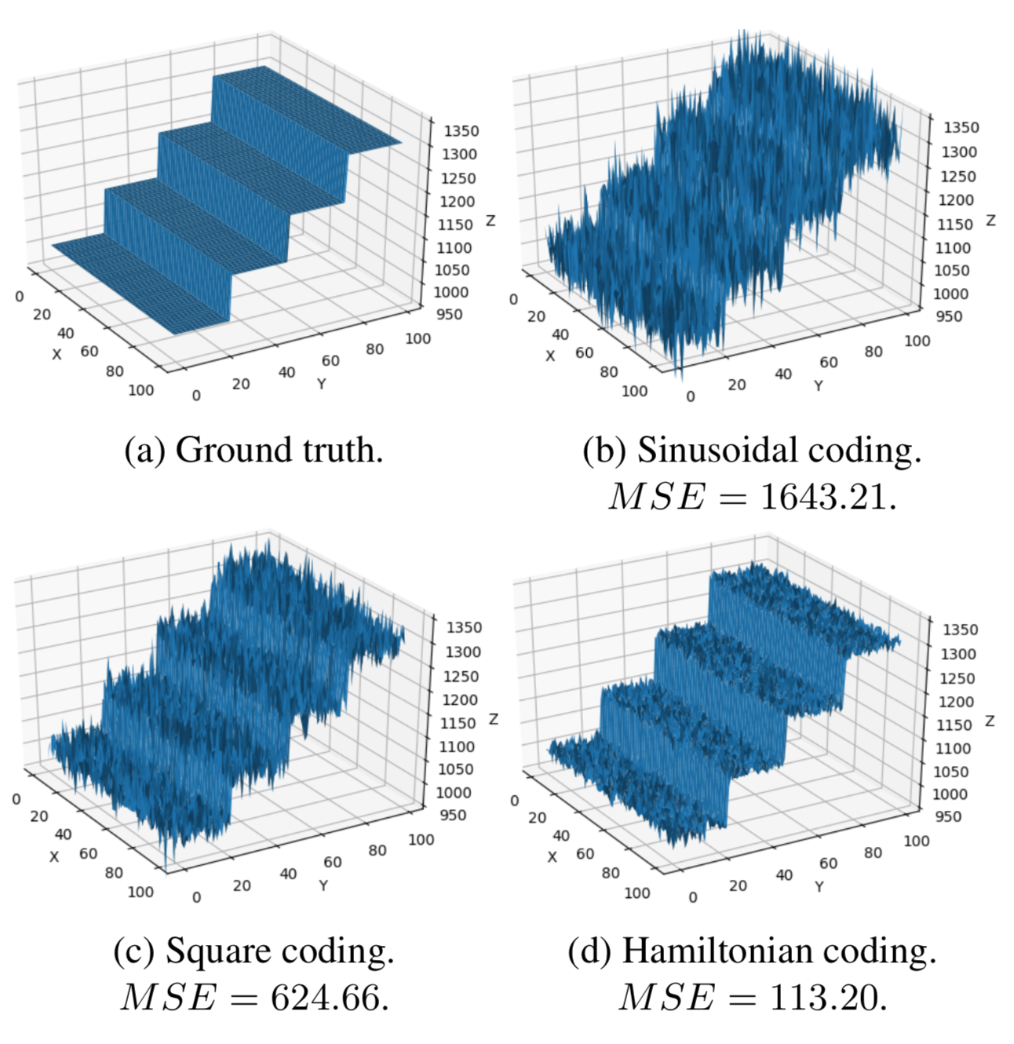
Time-of-Flight Coding Function Optimization
Jonas Messner, Nicholas Gaudio, {messnerj, nsgaudio}@stanford.edu
Department of Electrical Engineering, Stanford University
BACKGROUND and MOTIVATION
2. ARCHITECTURES
Continuous-Wave Time-of-Flight System Overview
Non-Neural Network Optimization Diagram
Neural Network Architecture
Received Light
Some BS 1
Some BS 2
Some BS 3
Sensor Demodulation Function
Cross-Correlation
Convolutional Neural Network Optimization Diagram
Coding Curves
3. RESULTS and DISCUSSION
1. DATASET
Recovered Depth Maps
Depth Precision
Coding Curve Length
FUTURE WORK
Model ensembling using data representations from sequence models
Implement the model on a smartphone for real-time inference
Incorporate frequency and phase traces into the sequence model
REFERENCES
[1] R. Ferriere, J. Cussey, and J. Dudley. Time-of-flight range detection using low-frequency intensity modulation of a cw laser diode: Application to fiber length measurement. Optical Engineering - OPT ENG, 47, 09 2008.
[2] R. Grootjans, W. van der Tempel, D. Van, C. De Tandt, and M. Kuijk. Improved modulation techniques for time-of-flight ranging cameras using pseudo random binary sequences. Proc. IEEE LEOS Benelux Chapter, 2006.
[3] M. Gupta, A. Velten, S. K. Nayar, and E. Breitbach. What are optimal coding functions for time-of-flight imaging? ACM Trans. Graph., 37(2):13:1–13:18, Feb. 2018.
[4] F. Gutierrez-Barragan, S. A. Reza, A. Velten, and M. Gupta. Practical coding function design for time-of-flight imaging. To appear in CVPR 2019, 2019.
[5] B. Hariharan, P. A. Arbelaez, R. B. Girshick, and J. Malik. Hypercolumns for object segmentation and fine-grained localization. CoRR, abs/1411.5752, 2014.
[6] A. Kolb, E. Barth, R. Koch, and R. Larsen. Time-of-flight cameras in computer graphics. Computer Graphics Forum, 29(1):141–159, 2010.
[7] R. Lange. 3D Time-of-Flight Distance Measurement with Custom Solid-State Image Sensors in CMOS/CCD-Technology. PhD thesis, University Siegen, 2000.
[8] P. Liu and E. Y. Lam. Image reconstruction using deep learning. CoRR, abs/1809.10410, 2018.
[9] P. K. Nathan Silberman, Derek Hoiem and R. Fergus. Indoor segmentation and support inference from rgbd images. In ECCV, 2012.
[10] A. Paszke, S. Gross, S. Chintala, G. Chanan, E. Yang, Z. DeVito, Z. Lin, A. Desmaison, L. Antiga, and A. Lerer. Automatic differentiation in PyTorch. In NIPS Autodiff Workshop, 2017.
[11] A. Payne, A. A Dorrington, and M. Cree. Illumination waveform optimization for time-of-flight range imaging cameras. Proceedings of SPIE - The International Society for Optical Engineering, 8085, 06 2011.
[12] M. Ravanelli and Y. Bengio. Speaker recognition from raw waveform with sincnet. In 2018 IEEE Spoken Language Technology Workshop, SLT 2018, Athens, Greece, December 18-21, 2018, pages 1021–1028, 2018.
[13] O. Ronneberger, P. Fischer, and T. Brox. U-net: Convolutional networks for biomedical image segmentation. CoRR, abs/1505.04597, 2015.
[14] M. Seyedhosseini, M. Sajjadi, and T. Tasdizen. Image segmentation with cascaded hierarchical models and logisticdisjunctive normal networks. In 2013 IEEE International Conference on Computer Vision, pages 2168–2175, Dec 2013.
[15] E. Shelhamer, J. Long, and T. Darrell. Fully convolutional networks for semantic segmentation. CoRR, abs/1605.06211, 2016

